Slide 1



Empowering You and Your Loved Ones

Slide 2





Brief introduction to end-of-
life planning
Importance of End-of-life Planning
Importance of discussing
and documenting end-of-life wishes
Introduce "Last Wishes" as a solution for managing end- of-life wishes

Slide 3


The Problem
Difficulty in initiating end-of-life conversations
Inadequate documentation of end-of-life wishes Emotional and financial burden on family members Miscommunication and potential disputes

Slide 4
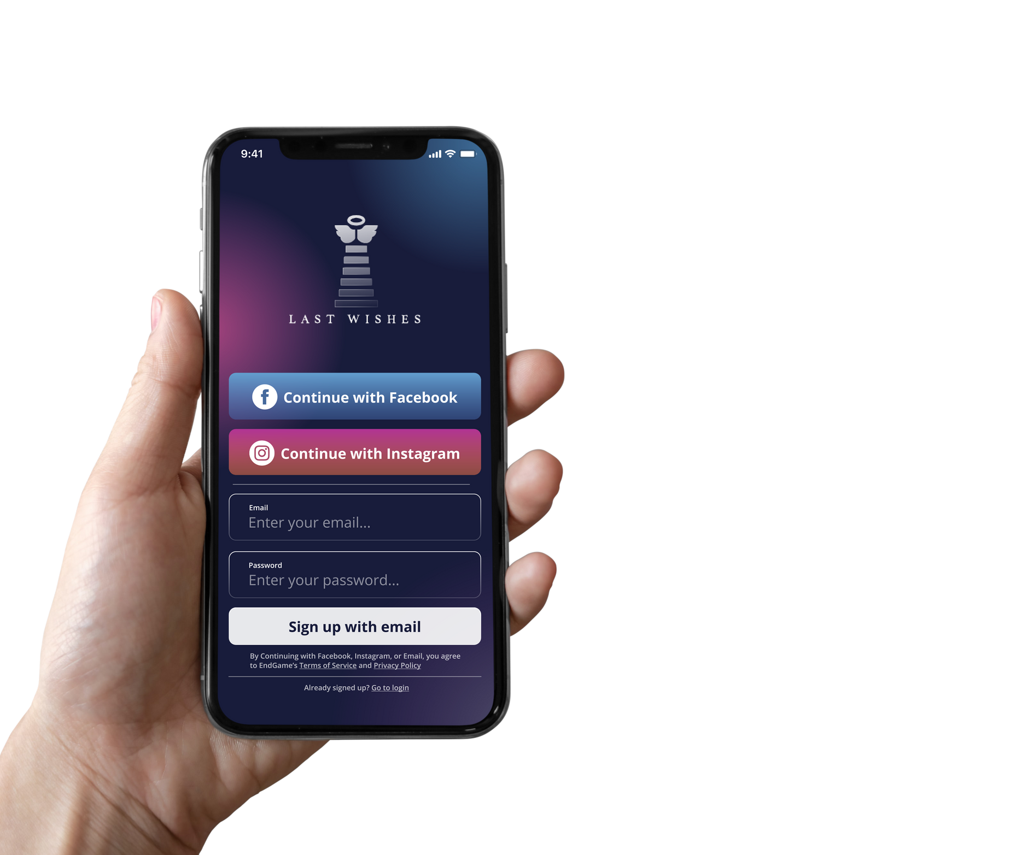


The Solution - Last Wishes
Key features of the platform:
Secure and easy-to-use platform for documenting end-of-life wishes
Customizable templates for advance directives and wills
Sharing options for family, friends, and healthcare providers
Contents contributed by family and friends Resources for understanding and discussing end- of-life planning

Slide 5







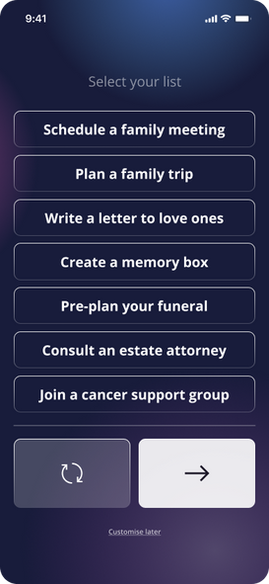





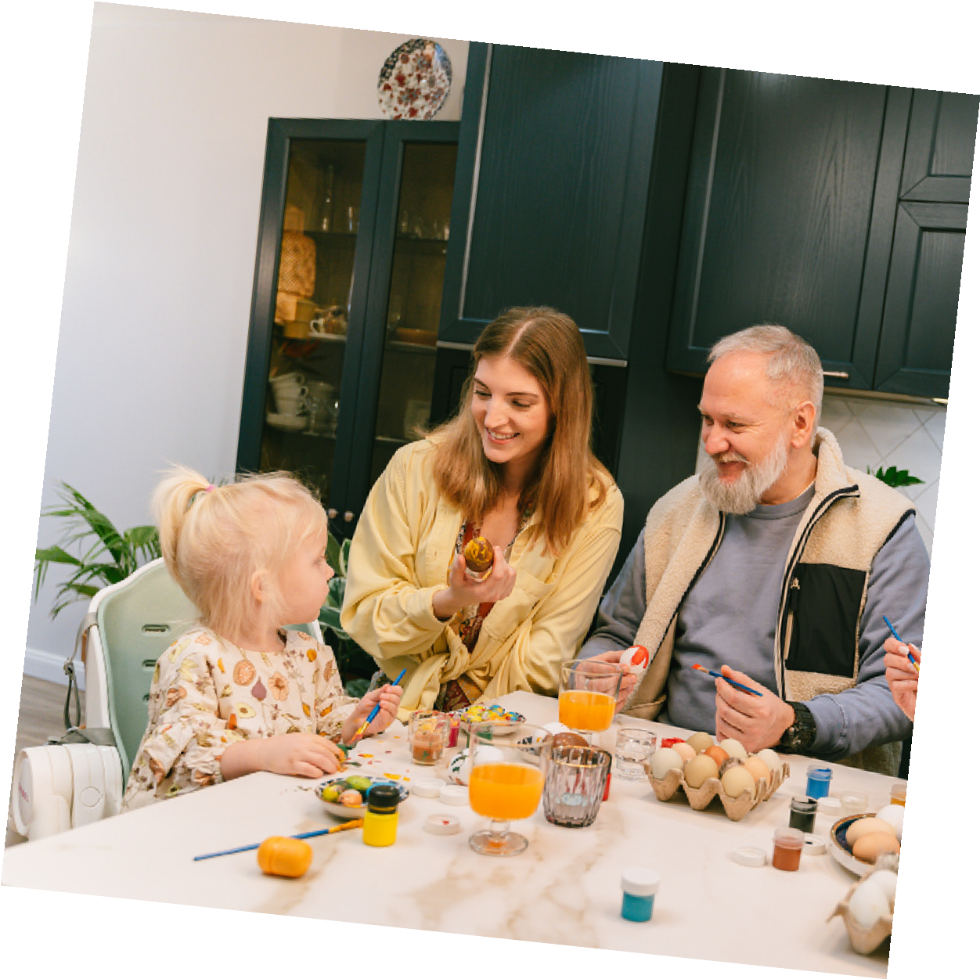

Process
Database
statistical model
Predict score for each wish that is stored within the common wish list
First 7 wishes of the highest score for users to select
Information fetch from social network

Slide 6



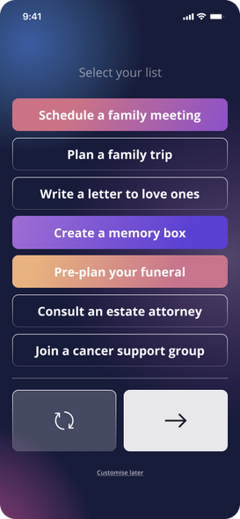
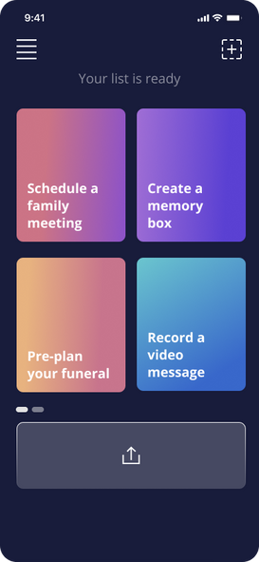
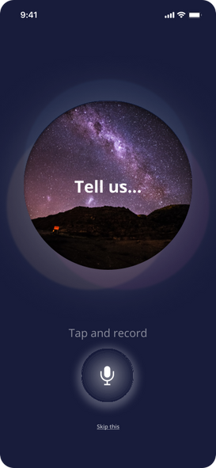
Share the wishes
Database
Sound Recording
statistical model
User's choice is fed-back
to the model to fine tune the model

Slide 7








Database model with machine learning Predict score for each wish that is stored within the common wish list
The model is trained using initial group of users's input of wishlist as response variable and personal info as predictor
Website
Pre-filled Content on website
Present the first 7 wishes of the highest score for users to select
The user's choice is fed-back to the model to fine tune the model
Database
statistical model

Slide 8
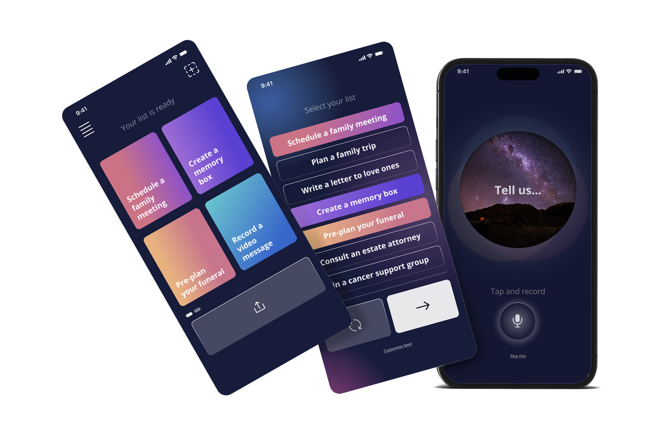


Slide 9






Technical Components
Technologies used: Figma, React, Node.js, MongoDB, etc.
Integration with healthcare providers and legal systems
Data security and privacy measures

Slide 10

Marketing and Outreach
Target audience: Adults aged 40 and above, caregivers, and
healthcare providers
Online marketing: SEO, social media, and targeted ads
Partnerships: Charities, Healthcare organizations, elder care services, and legal firms
Community outreach: Workshops, webinars, and support groups

Slide 11
Key Takeaways

